Slide 1
Unit -1
The Importance of the User Interface

Slide 2
The amount of programming code devoted to the user interface now exceeds 50 percent

Slide 3
Defining the User Interface
User interface design is a subset of a field of study called human-computer interaction
(HCI)
Definition of HCI: Human-computer interaction is the study, planning, and design of how people and computers work together so that a person’s needs are satisfied in the most effective way.
Definition of USER INTERFACE : user interface is the part of a computer and its software that people can see, hear,touch, talk to, or otherwise understand or direct

Slide 4
HCI designers must consider a variety of factors
  What people want and expect ?
  What physical limitations and abilities people possess ?
  How their perceptual and information processing systems work ?
  What people find enjoyable and attractive ?
  Technical characteristics and limitations of the computer hardware and software must also be considered.

Slide 5
What is User interface ?
A S/W or H/W through which we ( user ) is interacting ..

Slide 6
Components of user interface
Two components
1) Input.
2) Output.
Input : how a person communicates his/her needs to the computer.
Examples:-keyboard, mouse,trackball, one’s finger (for touch-sensitive screens), and one’s voice (for spoken instructions)
Output : how the computer conveys the results of its computations and requirements to the user
Examples : Printers, display screens, sound
The use of the human senses of smell and touch output in interface design still remain largely unexplored.

Slide 7
The Importance of Good Design

Slide 8
Why we produce systems that are inefficient & confusing ?
1. We don’t care?
2. We don’t possess common sense?
3. We don’t have the time?
4. We still don’t know what really makes good design?

Slide 9
History of screen design

Slide 10
communication modes
Moments & Gesture
Spoken Language
Written Language
Type writer
Text styles using keyboards
Question and Answer
Menu Selection,
Function Key Selection and Form Fill-In.
voice and handwriting

Slide 11
Introduction to Graphical user interface
1970s, Research at Xerox’s Palo Alto Research Center provided an alternative to the typewriter,
Primary HCI method mouse - pointing and selecting
Ivan Sutherland at the Massachusetts Institute of Technology (MIT) is given credit for first introducing graphics with his Sketchpad programin 1963

Slide 12
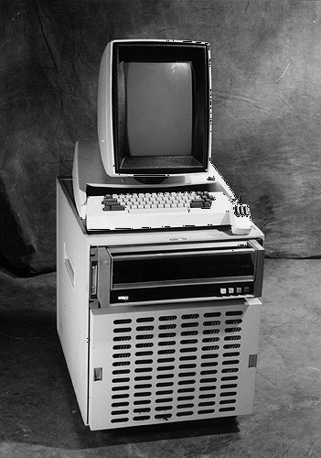
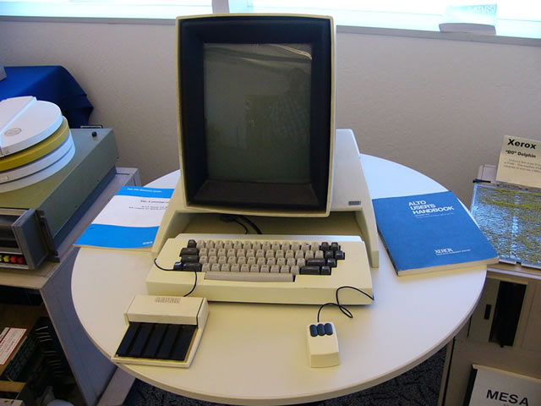
First to pull together all the elements of the modern GUI.
1973 Pioneered at the Xerox Palo Alto Research Center.

Slide 13
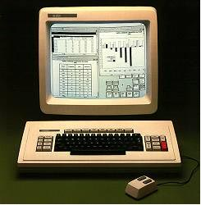
Widely introduced pointing, selection, and mouse.
1981 First commercial marketing as the Xerox STAR.

Slide 14
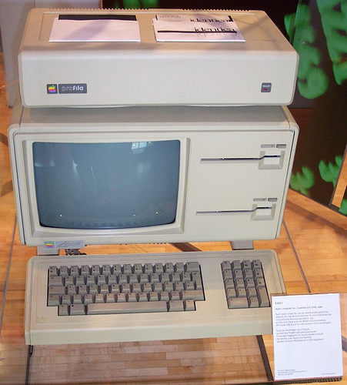
1983 Apple introduces the Lisa.
Apple Computer introduced the Apple Lisa (pictured),
their first commercial personal computer with a graphical user interface and a computer mouse.
It had 1 MB of RAM, and was priced at US $9,995

Slide 15
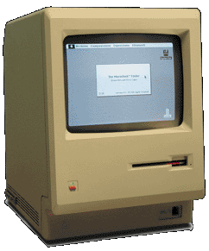
1984 Apple introduces the Macintosh.
1984 Apple Macintosh, first popular GUI computer:

Slide 16
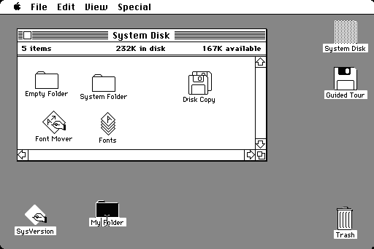
1984 Mac GUI:

Slide 17
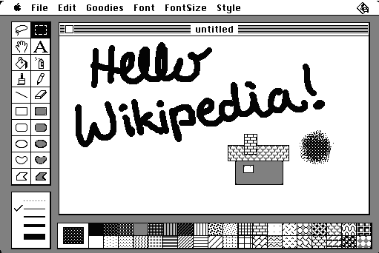
Screenshot of the included MacPaint

Slide 18
1985 Microsoft Windows 1.0 released.

Slide 19
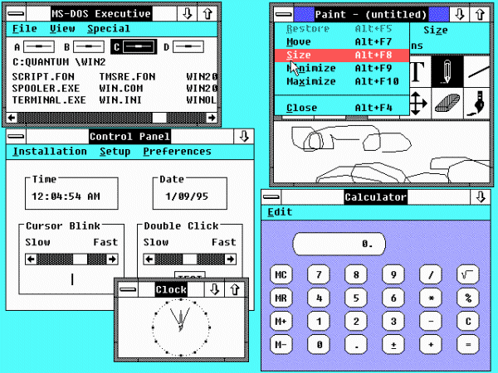
Windows 1.0

Slide 20
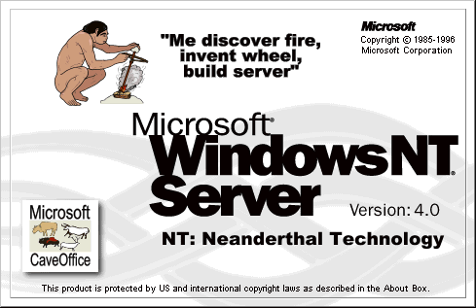
1993 Microsoft Windows NT released.

Slide 21
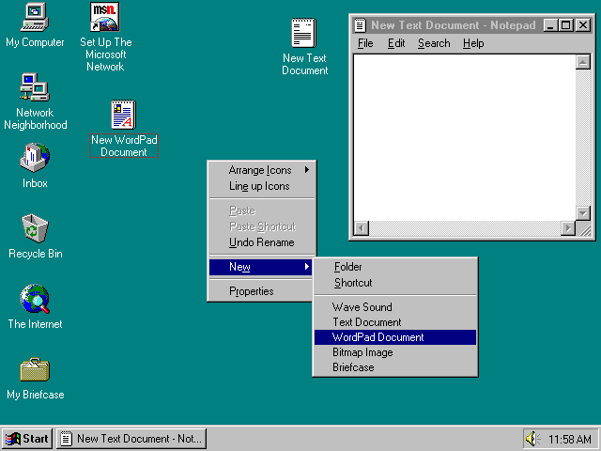
1995 Microsoft Windows 95 released.

Slide 22
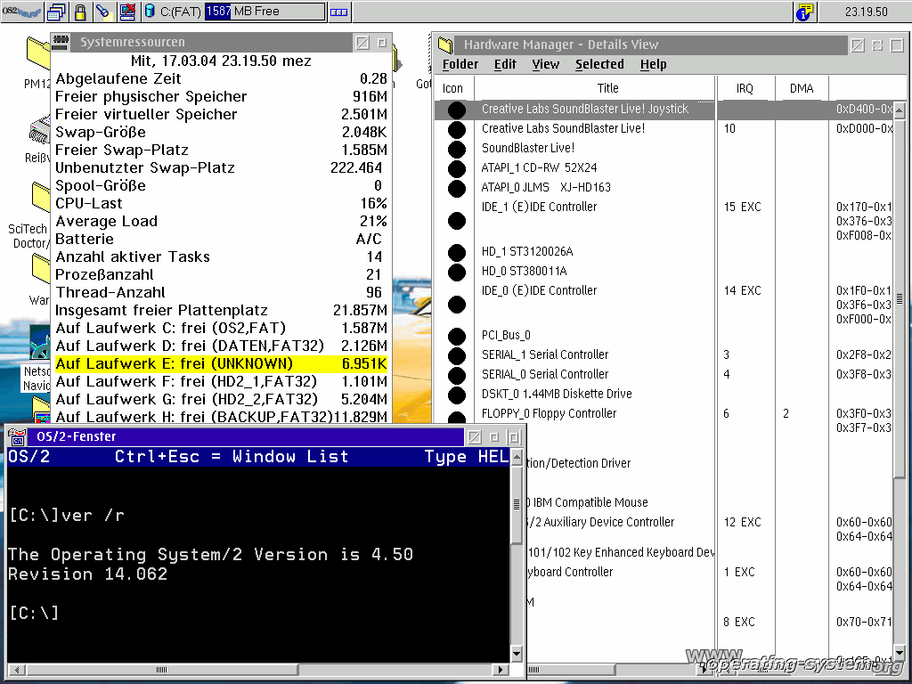
OS/2 Warp 4 1996

Slide 23
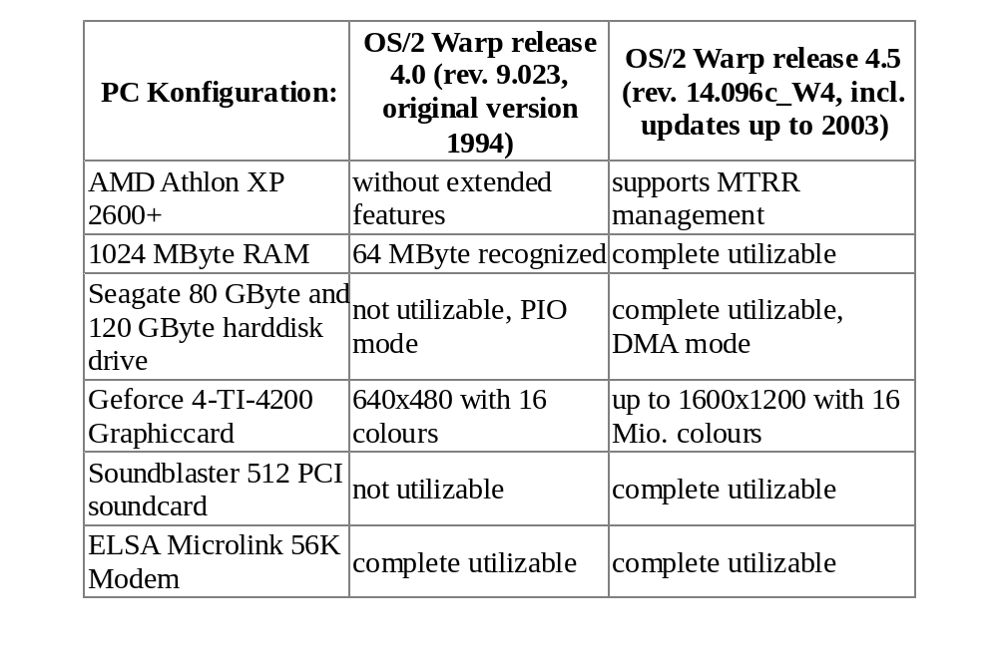

Slide 24
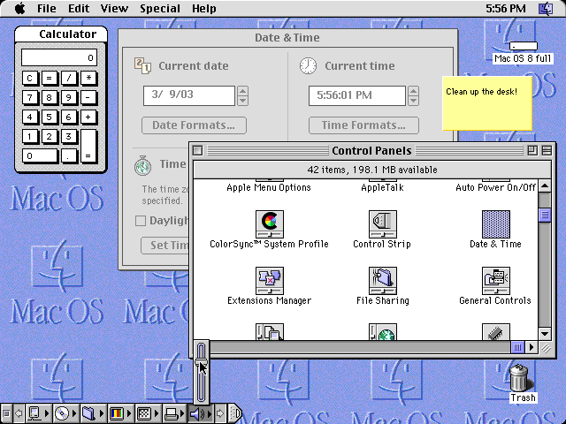
1997 Apple releases the Mac OS 8.

Slide 25
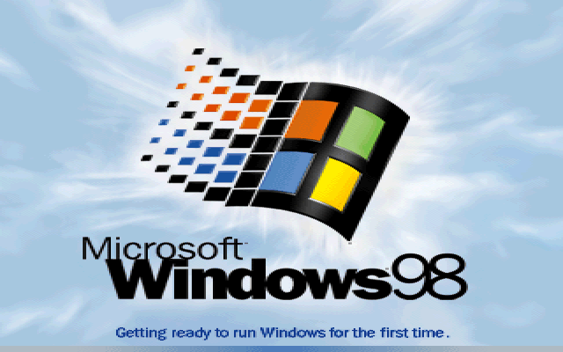
1998 Microsoft introduces Windows 98.

Slide 26
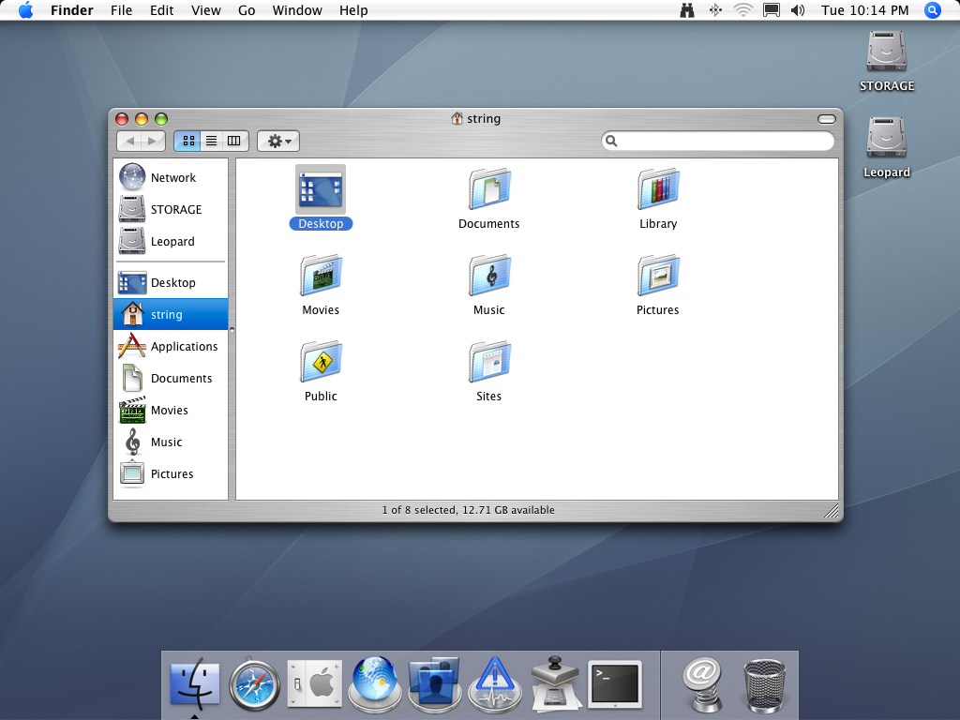
1999 Apple releases Mac OS X Server.
— A UNIX-based OS.

Slide 27
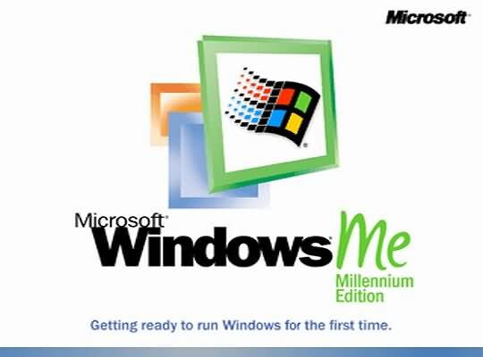
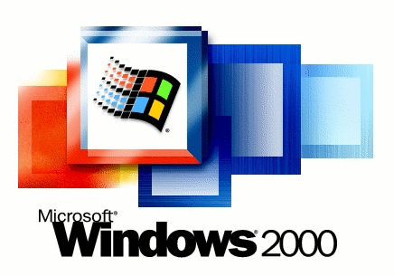
2000 Microsoft Windows 2000 released.
Microsoft Windows ME released

Slide 28
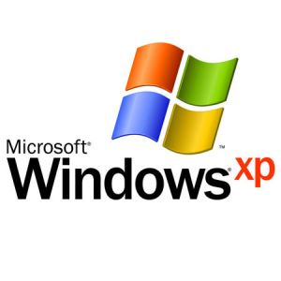
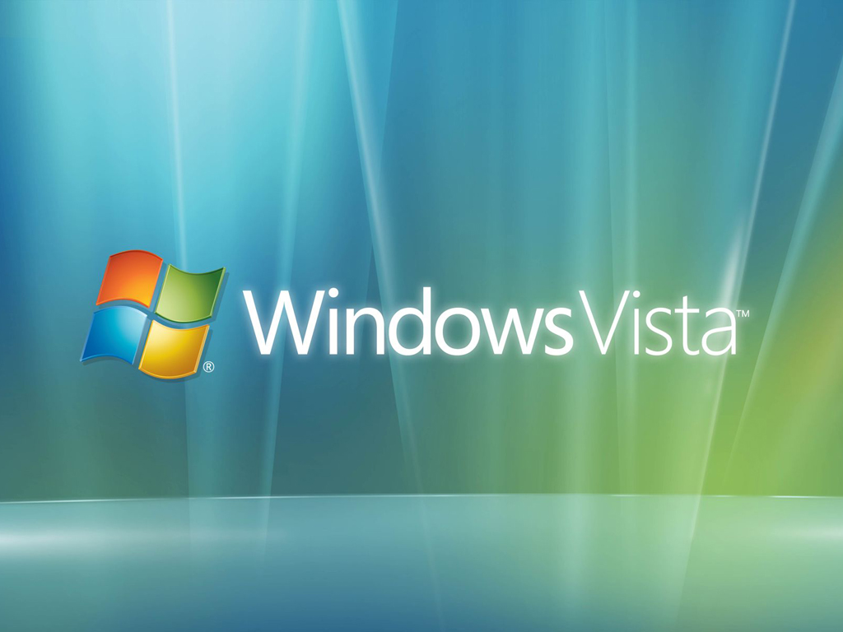
2001 Microsoft Windows XP released
Introduced in 2006

Slide 29

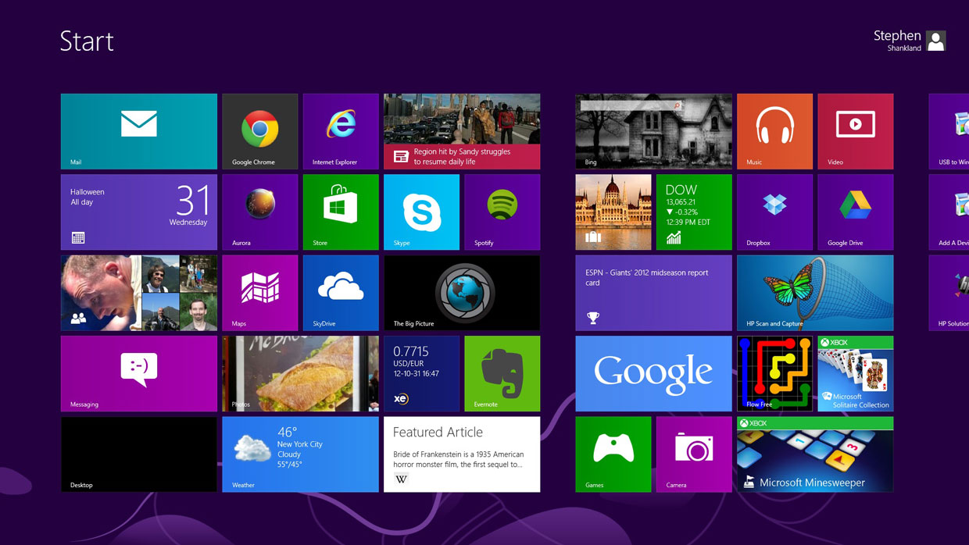
Introduced in 2009
Introduced in 2012

Slide 30
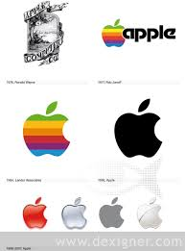

Slide 31
The Blossoming of the World Wide Web

Slide 32
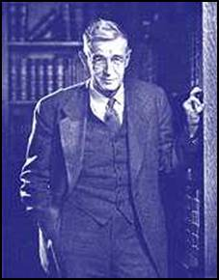
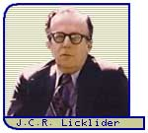
1945 Hypertext concept presented by Vannear Bush.
MIT scientist
"memory" and "index" called memex
1960 J. C. R. Licklider of MIT proposes a global network of computers.
computers where people "will set the goals, formulate the hypotheses, determine the criteria, and perform the evaluation."

Slide 33
Seeds of the Internet were planted in the early 1960s
J. C. R. Licklider of MIT proposed a global network of computers in 1962
1969 the Internet, then known as ARPANET, was brought online, connecting the computers at four major universities.
1974, Bolt, Beranek and Newman released Telenet.
Through the late 1970s and into the 1980s, the common language of all Internet computers, TCP/IP, was created
1982 the term Internet was coined.

Slide 34
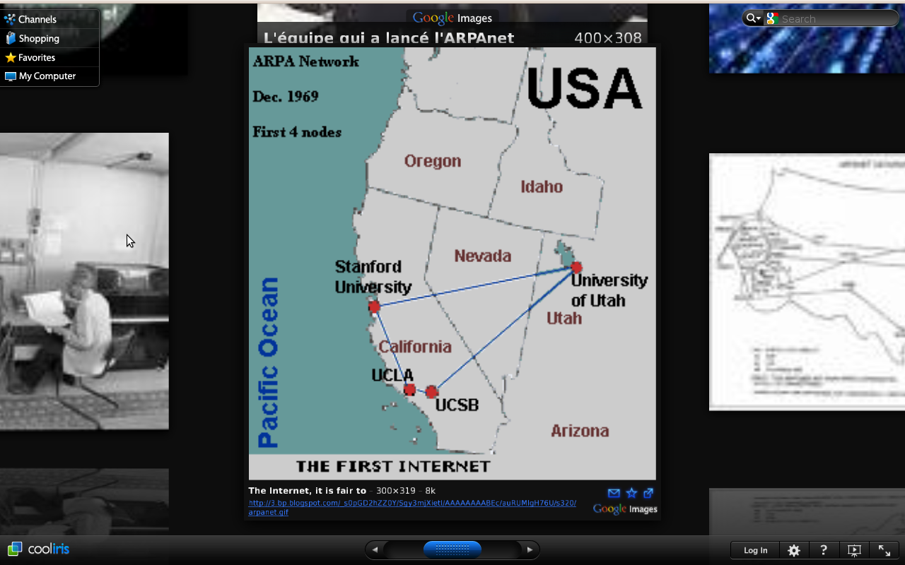
1962 Design and development begins on network called ARPANET

Slide 35
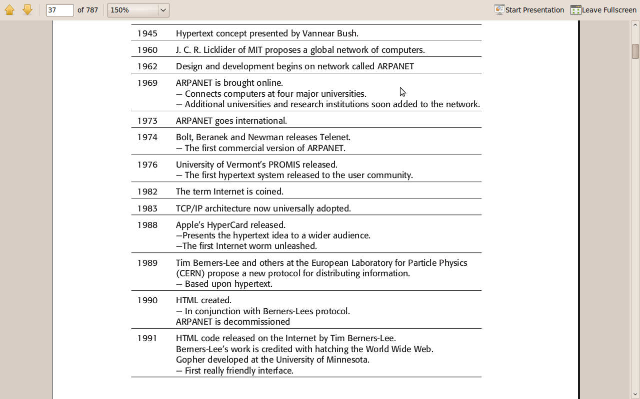

Slide 36
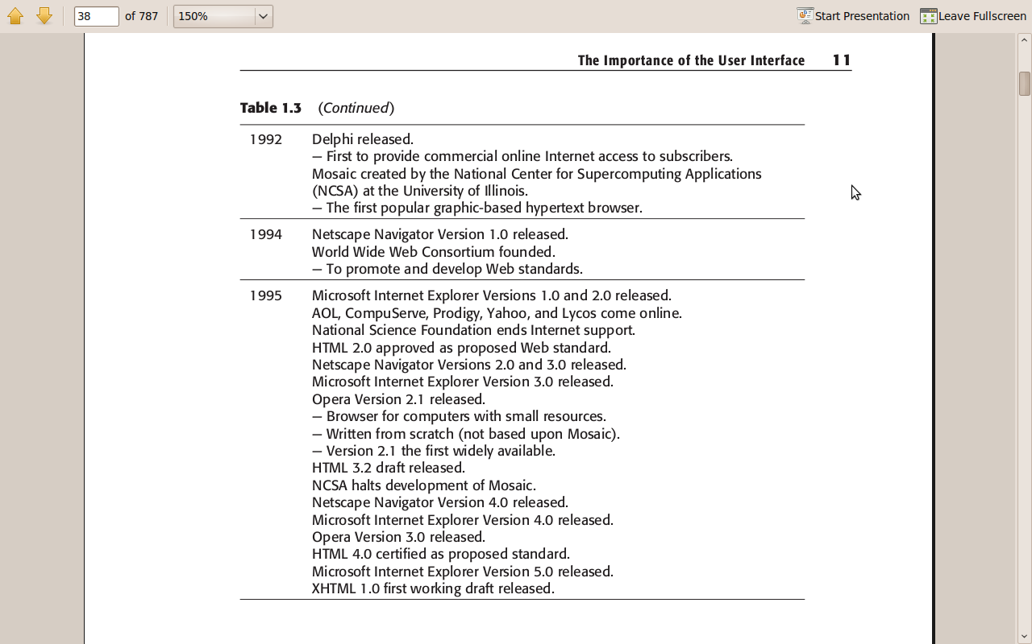

Slide 37

1982 The term Internet is coined.

Slide 38
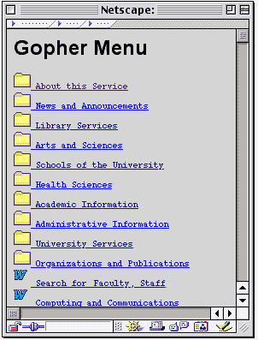
Gopher
Gopher offers downloadable files with some
content description to make it easier to find the file you need

Slide 39
A Brief History of Screen Design

Slide 40
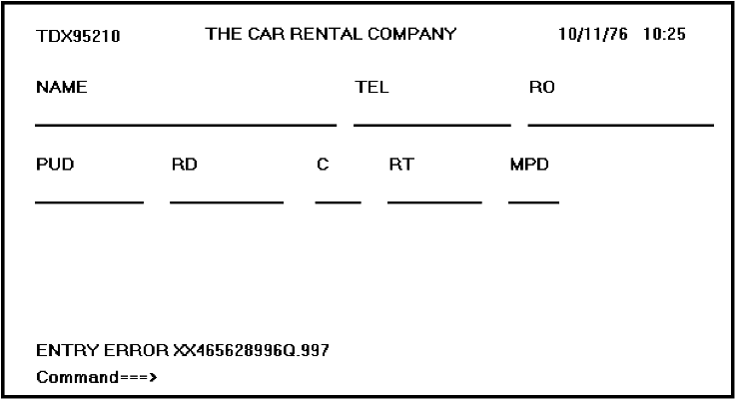
Figure 1.1 A 1970s screen.

Slide 41
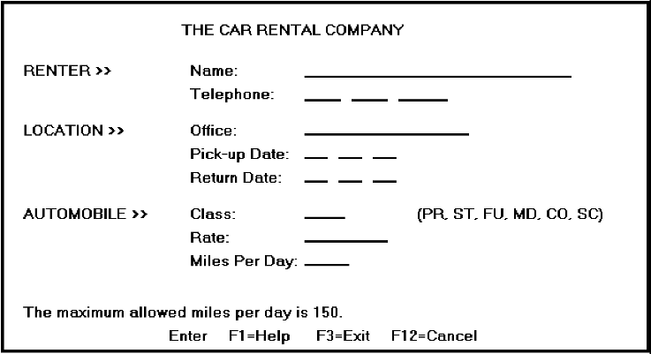
Figure 1.2 A 1980s screen.

Slide 42
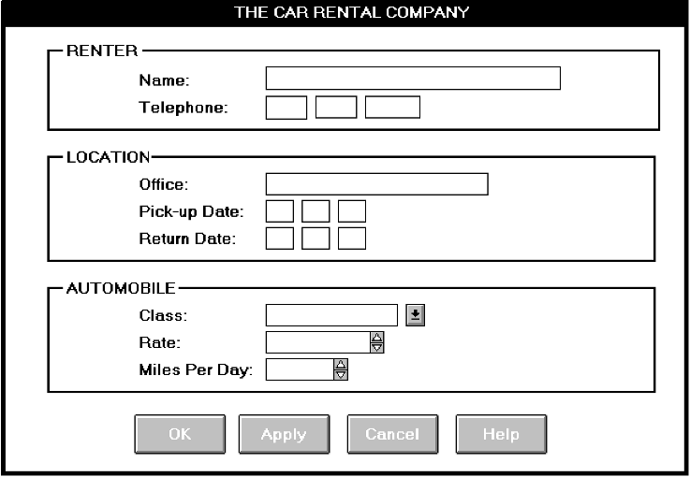
Figure 1.3 A 1990s and beyond screen.

Slide 43
In the 1990s, our knowledge concerning what makes effective screen design continued to expand

